Slide 1
Case study for Tasty Bytes
Shaker Fayez
Oct. 12, 2024

Slide 2
Outline
Project overview
Business goal
Data cleaning
EDA and data visualization
Data processing
Model development
Model evaluation
Business metric
Key findings
Recommendations

Slide 3
Introduction
There are many factors controlling the number of visits and customer conversion rate in our business, today we will experiment with our homepage recommended recipe, we believe that the suggested recipe on our website homepage has significant influence on the number of visits and the amount of time the customer spends on the website and thus conversion rate and revenue, some recipes attract significantly higher number of customers than others and we want to predict what recipes will be most popular and place them on the homepage.

Slide 4
Business goal
In our quest to predict which recipes will be popular on our website, we've been provided with a dataset by the product manager that includes key details on 947 recipes. This dataset, structured with seven columns, contains comprehensive nutritional information such as the number of calories, carbohydrates, sugars, and proteins each recipe contains. Additionally, it classifies each recipe into one of ten categories, ranging from 'Lunch/Snacks' to 'Desserts' and 'One Dish Meals', and also notes the number of servings. Crucially, the dataset includes a 'high_traffic' indicator, which signifies whether a recipe attracted high visitor traffic when featured on the homepage. This data will be instrumental in developing a model to predict traffic trends and, consequently, the popularity of recipes

Slide 5
Data cleaning
In our analysis of the recipe popularity prediction model, we've thoroughly reviewed the dataset of 947 recipes, confirming no duplicates and evaluating each column for data integrity. We adjusted the servings column to maintain its numeric data type for flexibility during model development. The high_traffic column was converted from an object type to boolean, representing "High" and "Low" traffic based on the presence or absence of values. In the category column, we reclassified an inconsistent "Chicken Breast" entry under "Chicken" to align with predefined categories like 'Lunch/Snacks', 'Beverages', and others. To address the 52 missing values in the nutritional content columns, which constitute 18.21% of our data, we filled these gaps using category and serving size-specific averages, ensuring data completeness without significant loss. With these corrections, our dataset is now ready for exploratory analysis and subsequent descriptive statistics computation, setting the stage for accurate predictive modeling of recipe popularity.

Slide 6
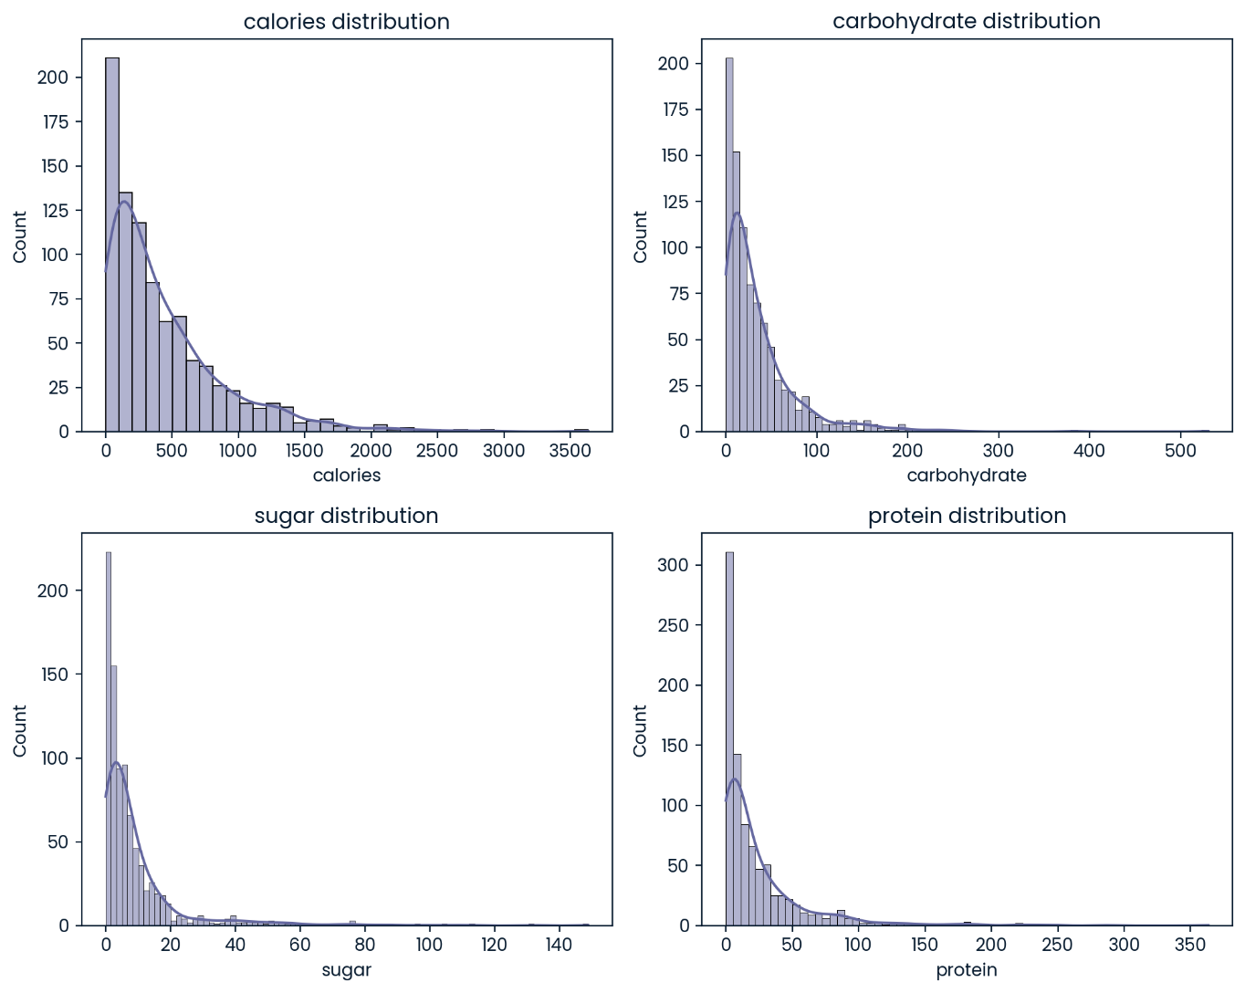
EDA
In our exploratory data analysis, the descriptive statistics have uncovered significant standard deviations in columns related to calories and nutritional components. These deviations, along with quantile-based observations of outliers, contribute to a right-skewed distribution across these metrics, suggesting that the data does not follow a normal distribution. Our analysis reveals that the medians for calories and nutritional components are not symmetrical and vary depending on the type of food and beverages. We will next examine the relationship between servings and high traffic status, observing that recipes from specific categories, particularly "Vegetable," "Potato," and "Pork," tend to generate higher traffic, whereas the "Beverages" category has a minimal impact.

Slide 7
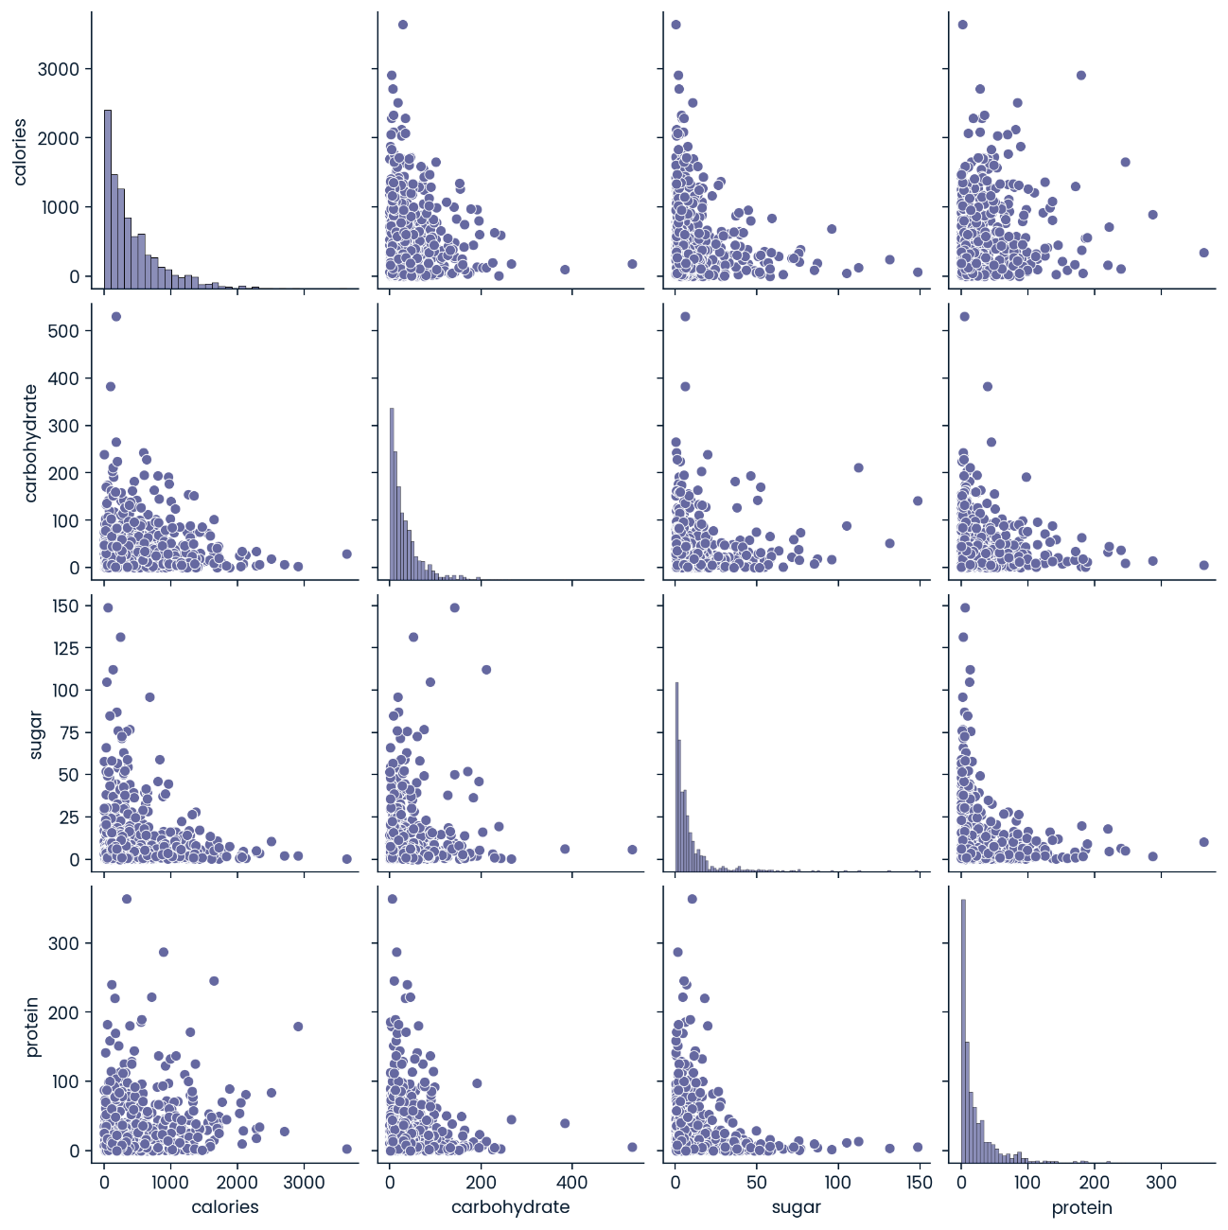
EDA cont.
To further delve into this pattern, we plan to utilize binary classification algorithms from supervised machine learning to predict high traffic status. We will initially implement Logistic Regression and consider other models like Decision Tree, Random Forest, and Support Vector Machines for subsequent comparison. Before deploying Logistic Regression, we must address outliers in our data by calculating the Interquartile Range (IQR) to manage them effectively and strengthen our model.

Slide 8
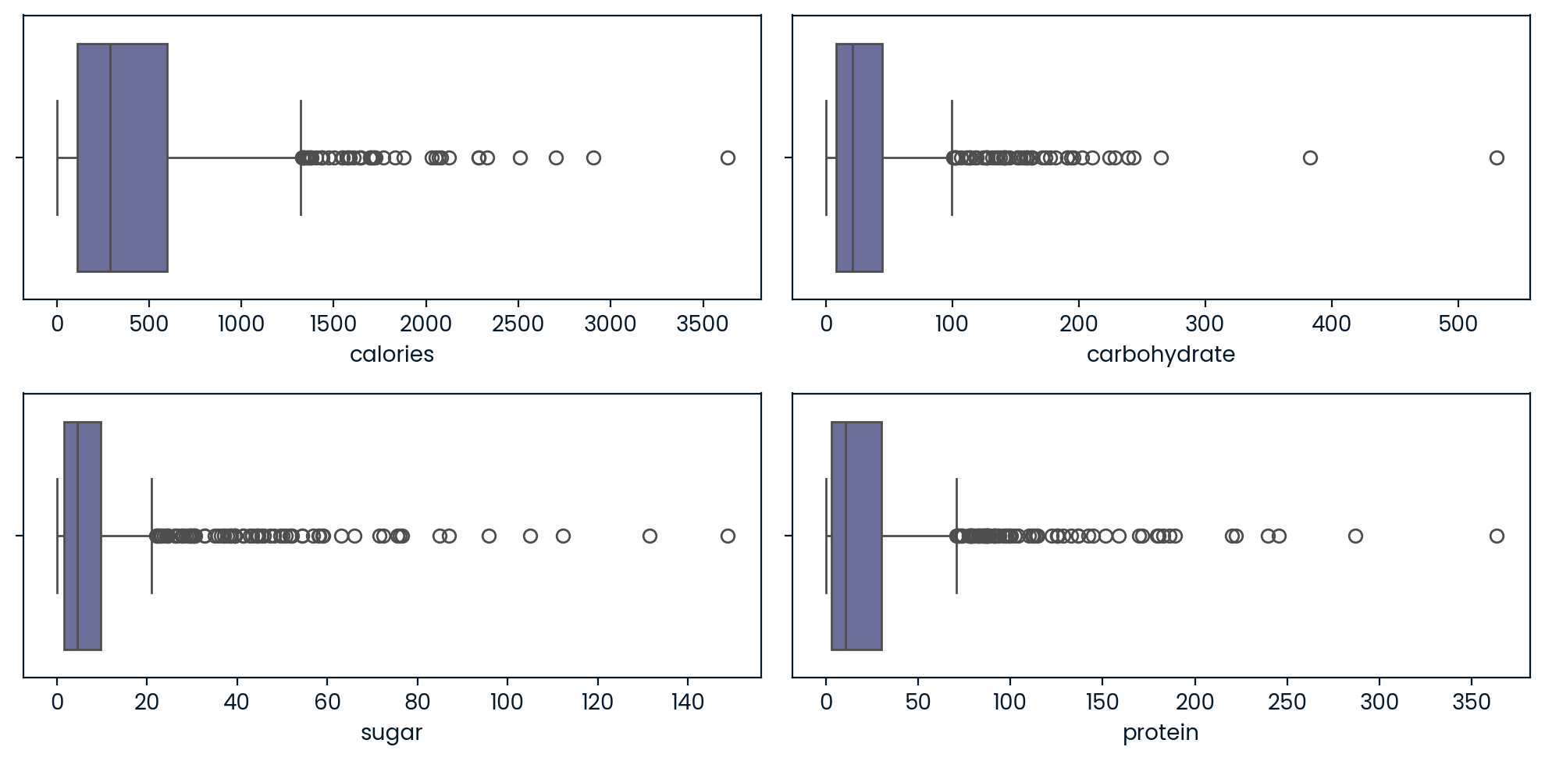
EDA cont.
High values in our data require attention. Directly removing outliers causes significant data loss, so we avoid this approach. After testing transformations like Logarithmic, Square Root, Square Root method proved most effective, especially since some columns contain zero values, which complicates other methods.

Slide 9
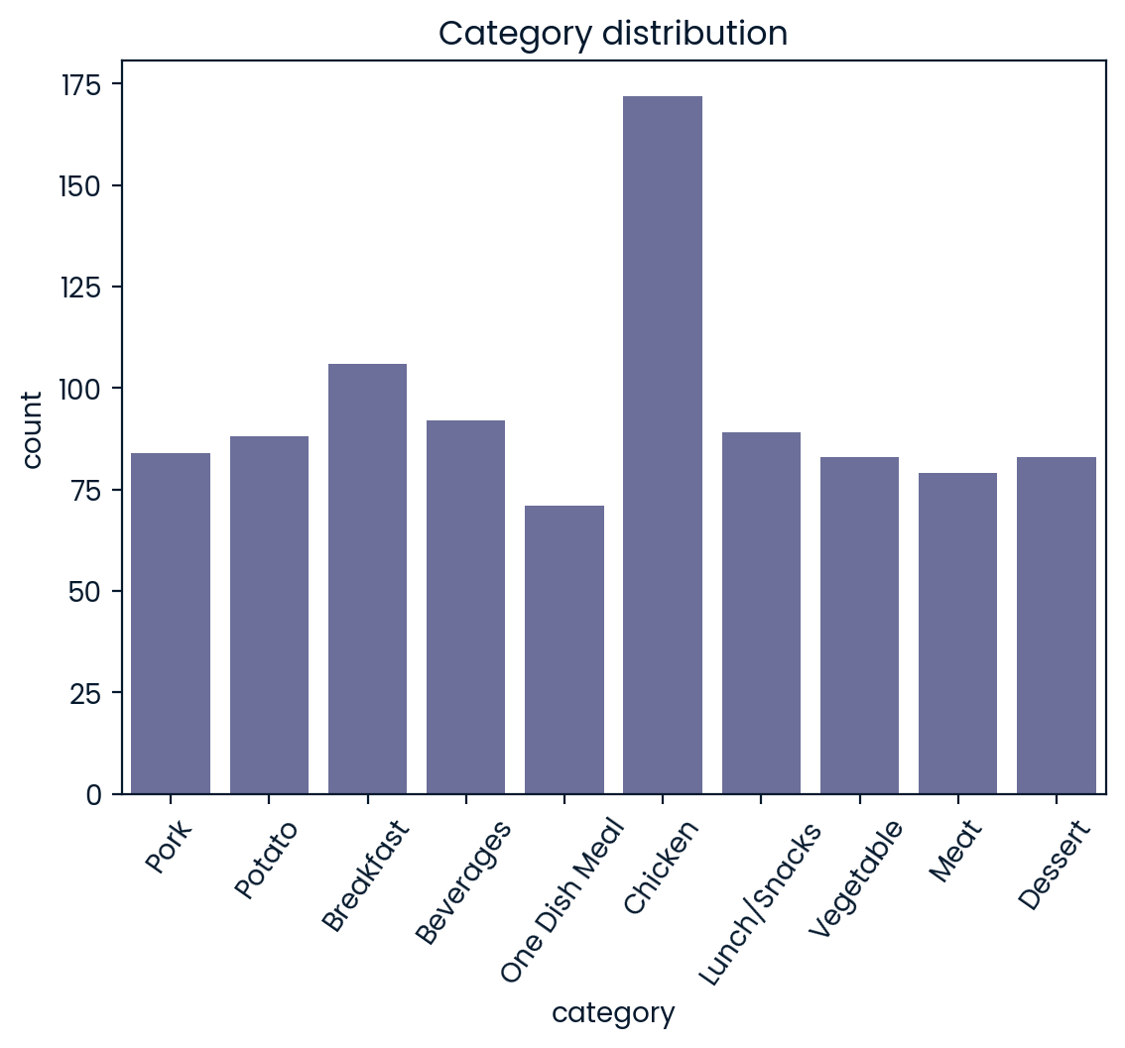
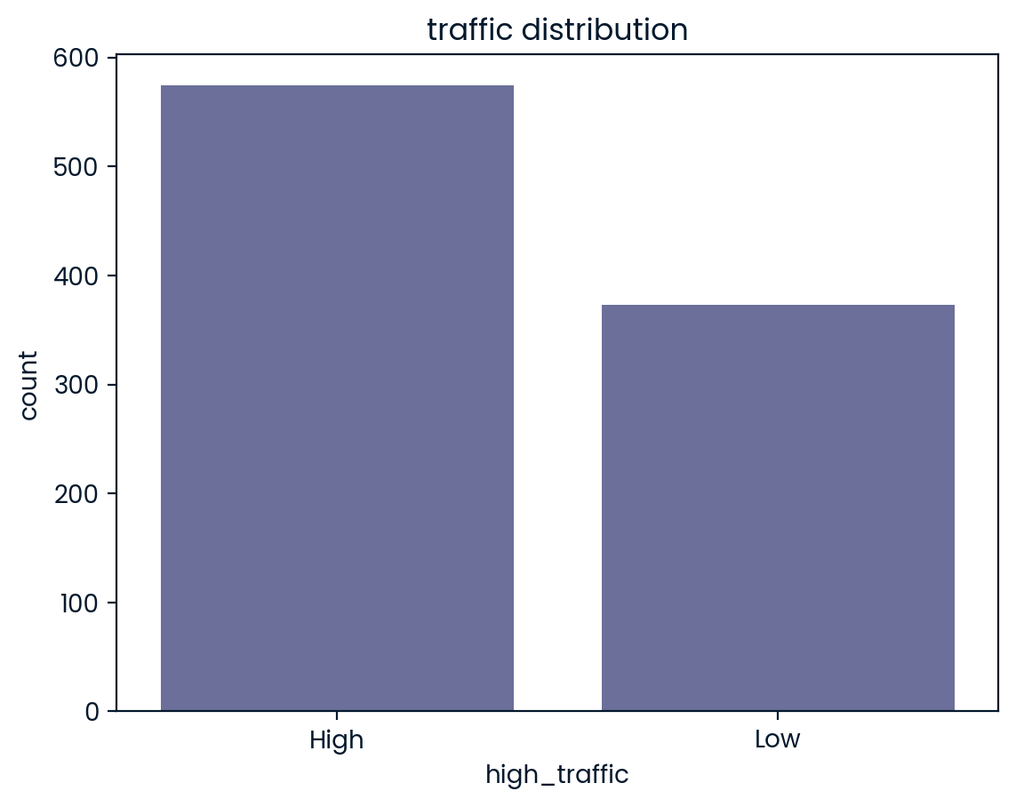
EDA cont.

Slide 10
Data processing
After the cleaning process comes the processing process to prepare the data for deeding into the model, this phase includes standardizing the data to have the same mean and standard deviation and thus satisfy a very important prerequisite of a lot of machine learning algorithms, next comes the encoding phase in which we transform the text data into numeric to be ready for modeling phase, we used a class called LabelEncoder to encode the response variable into binary one, True and False and another function called get_dummies for encoding the category feature into multiple binary features.

Slide 11
Model development and evaluation
For model development, we removed the 'recipe' ID as it is irrelevant for analysis and classification. We selected calories, carbohydrate, sugar, protein, servings, and category as features, with high_traffic as the target variable. The categorical 'category' variable was converted to a numeric feature through encoding. 06 Our modeling process will proceed with these steps: 1. Data Splitting: Separate the dataset into features (X) and the target variable (y), focusing on "high_traffic". 2. Train-Test Split: Use the `train_test_split` function from the scikit-learn library to divide the data into training and testing sets. 3. Model Development: Create a baseline model and compare it with additional models. 4. Model Training and Prediction: Train the chosen model on the training data and make predictions on the testing data, also checking for overfitting with the `predict` method. These steps will guide us in creating and evaluating our baseline and comparison machine learning models.

Slide 12
Model evaluation cont.
Model/Metric | Logistic regression | Decision tree | Random forest | Gradient boosting
Accuracy | Accuracy : 0.77 | Accuracy : 0.76 | Accuracy : 0.80 | Accuracy : 0.85
Precision | Precision : 0.8 | Precision : 0.72 | Precision : 0.73 | Precision : 0.83
Confusion matrix | [[205 91] [ 89 372]] | [[295 1] [ 2 459]] | [[294 2] [ 1 460]] | [[ 68 228] [ 4 457]]

Slide 13
Business metric and findings
We have two business objectives: 1. Predict which recipes will experience high traffic. 2. Accurately forecast the "High" traffic status of recipes with at least an 80% probability. The Logistic Regression model has successfully met both goals without the overfitting issues seen in the Random Forest and Decision Tree models. This is evidenced by its high rates of Precision, Recall, and F1 Score, all of which are 80% or higher.

Slide 14
Recommendations
To support the Product Manager in predicting high traffic for recipes, we recommend deploying the Logistic
Regression Model. With an accuracy rate of approximately 81%, this model boosts confidence in effectively driving traffic across the website.
Model Deployment Steps:
1. Deployment Strategy: Outline implementation methods.
2. Data Collection: Gather diverse data to enhance learning.
3. Feature Engineering: Develop sophisticated features for better accuracy.
Key Insights:- The Logistic Regression model proved most effective, achieving around 80% accuracy.- We prioritized precision to avoid significant business losses from misclassification.- We introduced a "High Traffic Conversion Rate" KPI for performance assessment.- Categories like "Vegetable," "Potato," and "Pork" consistently drive high traffic, while "Beverages" attract less,
guiding promotional strategies on the website.
These strategies and insights will guide our efforts in optimizing recipe visibility and engagement

Slide 15
Questions?

